Slide 1


Social Mobility Day 2025
Supporter toolkit

Slide 2

What is Social Mobility Day?
On Thursday 12 June 2025, the Sutton Trust will be highlighting the importance of social mobility. It’s an opportunity for our partners and supporters to share their successes, experience and knowledge around social mobility, these will then showcase the benefits of social mobility for other businesses, such as increased talent and business growth.
The purpose of
this toolkit
To provide Sutton Trust partners with tools, including social media cards and content to help raise awareness of social mobility day, share stories around social mobility and highlight it’s importance.
What is included
in this toolkit
How you can
get involved!
Download the social media cards and make them your own. Share the successes at your company and what social mobility means to your organisation and your successes.
This toolkit includes a range of different social media cards that can be shared on multiple platforms including; LinkedIn, BlueSky, X and Instagram.
The toolkit also shares some suggested messaging.

Slide 3
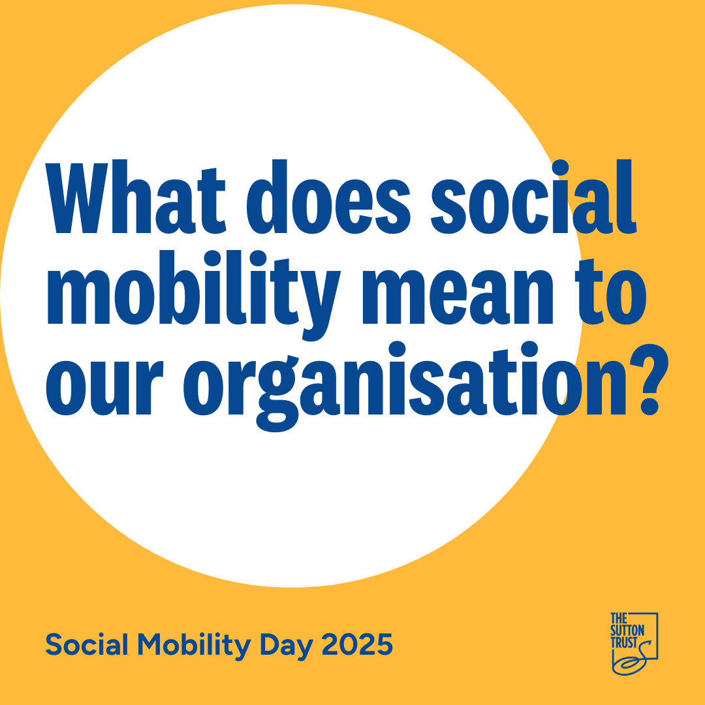
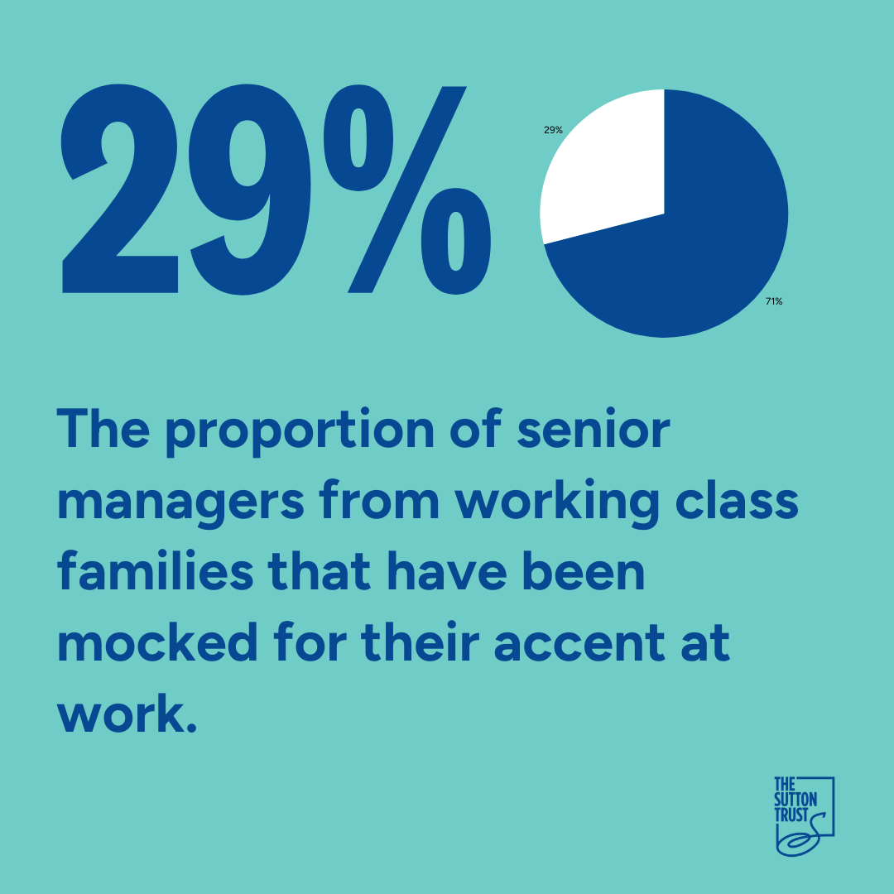
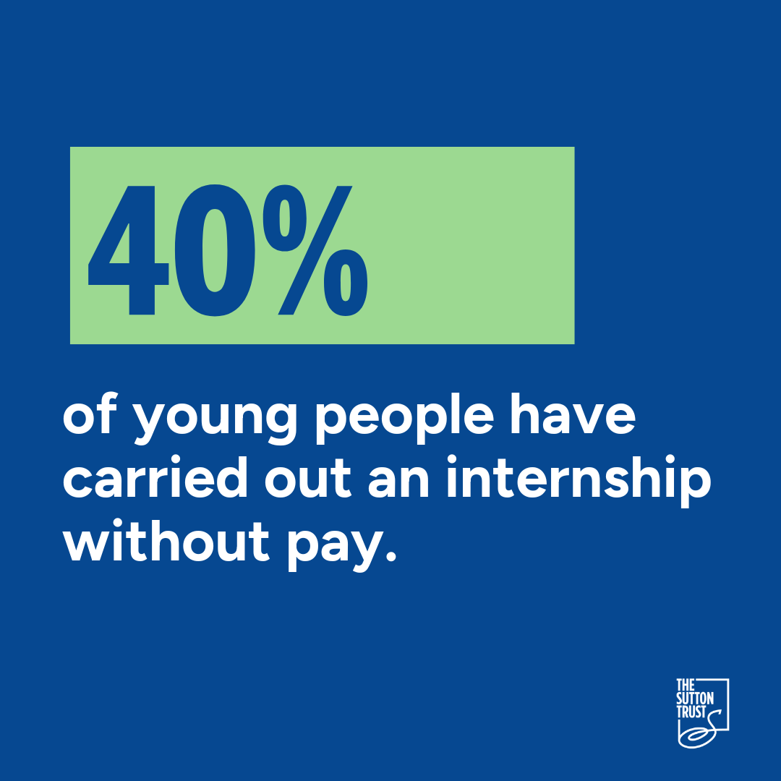


Social media cards
Save the social media graphics below as an image and use them across LinkedIn, BlueSky or X.
Share what social mobility means to your organisation alongside this social media graphic.
Share your workplace/ accent experience and insight as text alongside this social media graphic.
Share any insight your company has on internships and accessibility alongside this social media graphic.
Share why your organisation is supporting Social Mobility Day alongside this social media graphic.

Slide 4
Share our content on X, Bluesky, Instagram or LinkedIn. Remember to use @The Sutton Trust and #socialmobilityday #shiftmindsets
Key things to remember when sharing your social media posts:
- Share a picture or one of our social media graphics alongside your post as this will increase engagement
- The focus is shifting mindsets around social mobility so use the hashtag #Shiftmindsets to be part of the movement
- Use your companies experience with social mobility and any successes you have had in building a workforce with diverse socio-economic backgrounds
- Tag the Sutton Trust when you share your post
- Keep your post concise and not too long, we have some suggested copy below that you can edit and add to:
Today on #SocialMobilityDay we’re raising awareness to #shiftmindsets around social mobility.
Social mobility is about empowering individuals from less advantaged socio-economic backgrounds, changing outdated narratives and shifting perspectives.
Social mobility is crucial to achieving a fairer, more productive, more prosperous society for all.
This #SocialMobilityDay we’re highlighting our support for @The Sutton Trust to raise awareness and #shiftmindsets around social mobility.

Slide 5
What do we mean by Social Mobility?
What is Social Mobility? - The Sutton Trust
    Social mobility is the link between someone’s socio-economic (or “class”) background – the social and economic circumstances they grew up in – and their own outcomes as adults.
    Social mobility is crucial to achieving a fairer, more productive, more prosperous society for all. When everyone can reach their full potential, more talent can flourish, businesses grow and so does the economy, making social mobility a key to inclusive growth.
      9 in 10
    The proportion of people who think it’s important to level the playing field and improve social mobility in the UK.

Slide 6

Any questions?
Get in touch:
development@suttontrust.com
media@suttontrust.com

