Slide 1
Social Mobility Day 2025
Alumni Toolkit

Slide 2
What is Social Mobility Day?
On Thursday 12 June 2025, the Sutton Trust will be highlighting the importance of social mobility. It’s an opportunity for our alumni to share their stories and experience of social mobility, these stories will also showcase the benefits of social mobility for businesses and the importance of building a workforce with diverse socio-economic backgrounds.
The purpose of this toolkit
To provide the Sutton Trust alumni community with tools, including social media cards and content to help raise awareness of social mobility day, share stories around social mobility and highlight its importance.
What is included
in this toolkit
How you can get involved
Download the social media cards and make them your own! Use your own stories alongside the social media cards to share what social mobility means to you for Social Mobility Day 2025!
This toolkit includes a range of different social media cards that can be shared on multiple platforms including; LinkedIn, BlueSky, X and Instagram. The toolkit also shares some suggested messaging.

Slide 3
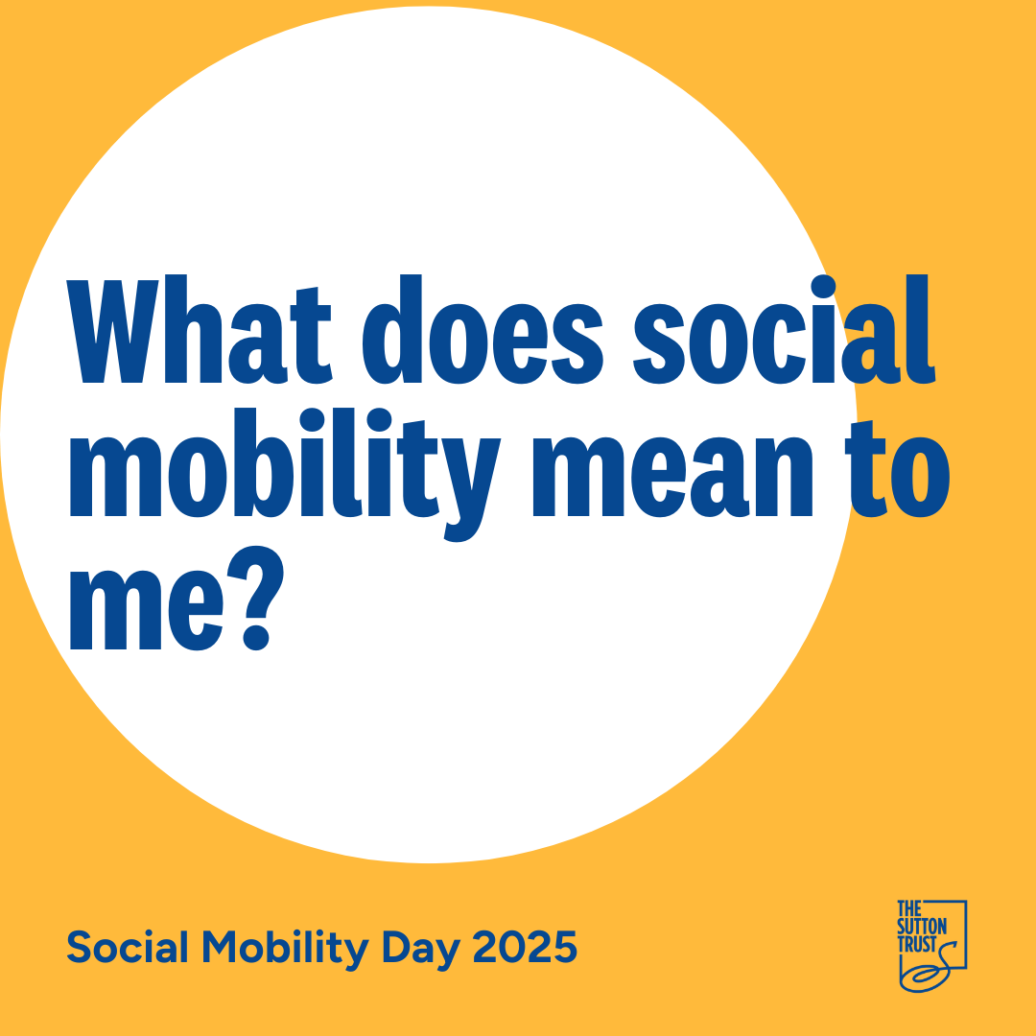
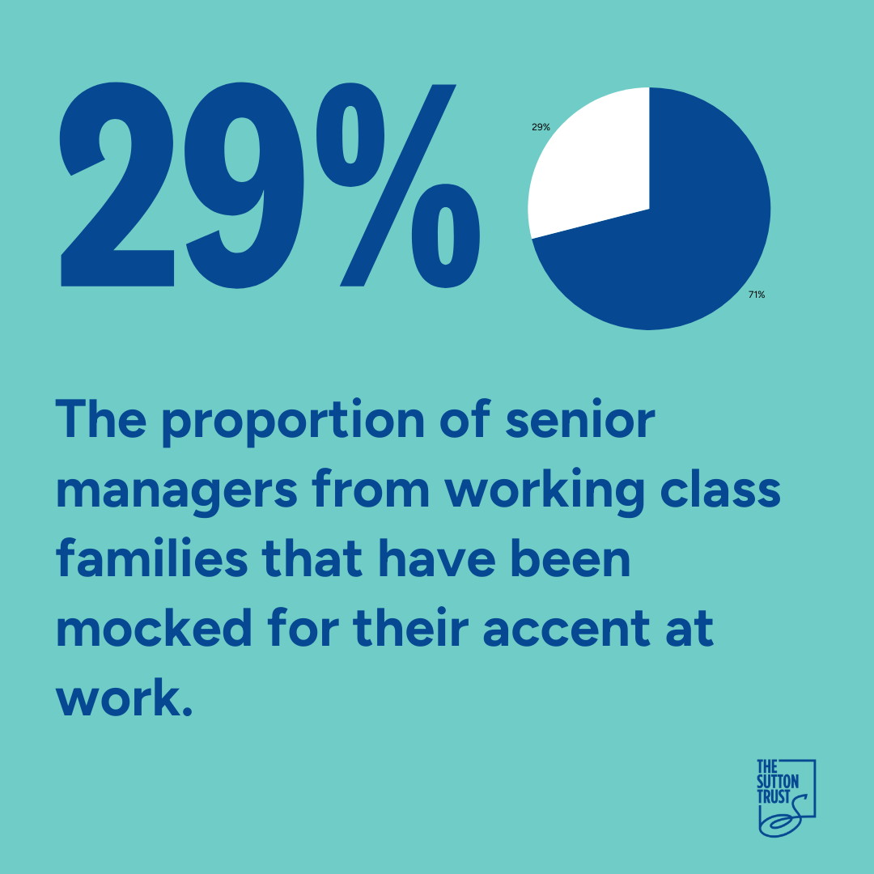
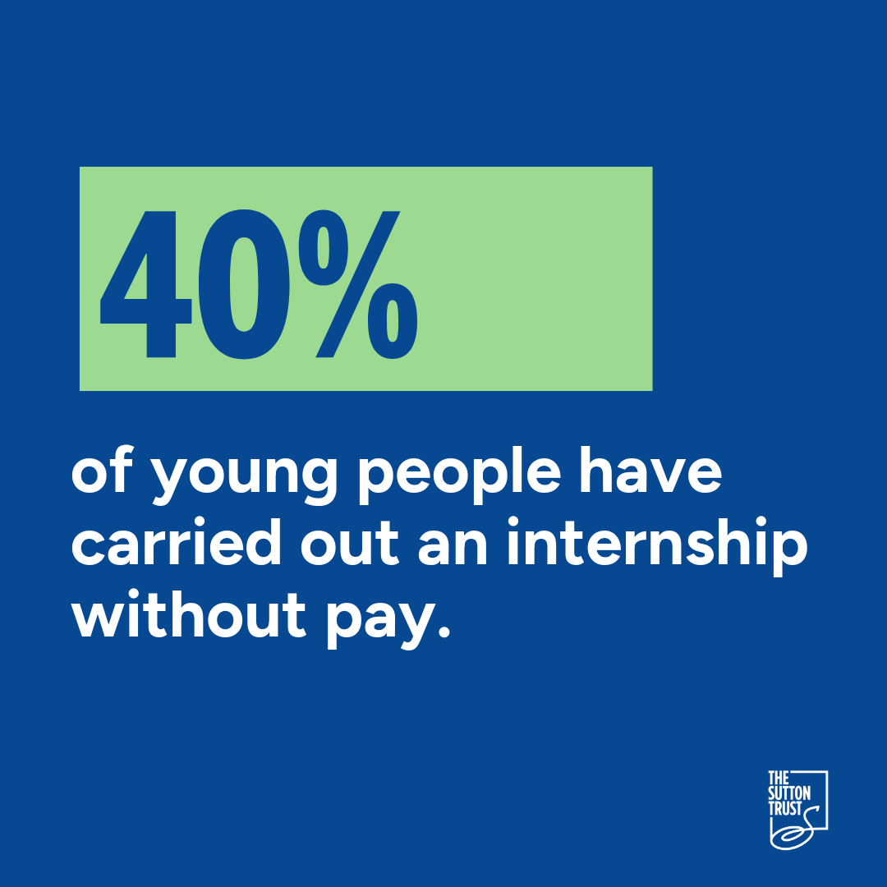
Social media cards
Save the social media graphics below as an image and use them across LinkedIn, BlueSky, X or Instagram.
Share your social mobility story or experience as text alongside this social media graphic.
Share your workplace/ accent experience and insight as text alongside this social media graphic.
Share your experience of internships or access to the workplace alongside this social media graphic.
Share your experience of social mobility or experience alongside this social media graphic.

Slide 4
Share our content on X, Bluesky, Instagram or LinkedIn. Remember to use @The Sutton Trust and #socialmobilityday #shiftmindsets
You can also share a recorded video for Social Mobility Day on TikTok to engage with Social Mobility Day on a range of different social media platforms.
Key things to remember when sharing your social media posts: - Share a picture or one of our social media graphics alongside your post as this will increase engagement
- The focus is shifting mindsets around social mobility so use the hashtag #Shiftmindsets to be part of the movement
- Use your story to showcase the benefits of social mobility for businesses and the importance of building a workforce with diverse socio-economic backgrounds
- Keep your post concise and not too long, we have some suggested copy below that you can add to:
Today on #SocialMobilityDay I’m sharing my experience to raise awareness and #shiftmindsets around social mobility. Social mobility is about empowering individuals from less advantaged socio-economic backgrounds, changing outdated narratives and shifting perspectives.
There are many people who come from similar backgrounds to me across the country. They have both ability and ambition.
This #SocialMobilityDay I’m sharing my experience to raise awareness and #shiftmindsets around social mobility.

Slide 5
What do we mean by Social Mobility?
What is Social Mobility? - The Sutton Trust
Social mobility is the link between someone’s socio-economic (or “class”) background – the social and economic circumstances they grew up in – and their own outcomes as adults.
Social mobility is crucial to achieving a fairer, more productive, more prosperous society for all. When everyone can reach their full potential, more talent can flourish, businesses grow and so does the economy, making social mobility a key to inclusive growth.
9 in 10
The proportion of people who think it’s important to level the playing field and improve social mobility in the UK.

Slide 6
Any questions?
Get in touch!
alumni@suttontrust.com
media@suttontrust.com

