Slide 1
2022 - 2023
Sutton Trust Programmes
“Opportunities like this do not come around often but when you get the chance, grab it! They change your life!”
www.suttontrust.com

Slide 2
About The Sutton Trust
The Sutton Trust champions social mobility from birth to the workplace through programmes, research and policy influence.
THE SUTTON TRUST
Notes:
Who are the Sutton Trust?​
​
Sutton Trust champions social mobility from birth to the workplace through programmes research and policy influence​
​
We do this by focussing on access and quality in five key areas:​
Early Years​
Schools​
Apprenticeships​
Universities​
Workplaces​
​
Since being founded in 1997, the Sutton Trust have worked with over 40,000 students on programmes, released agenda setting research and influenced a number of policies at the local and national level to aid social mobility so that someone’s background doesn’t determine what they should achieve in life

Slide 3
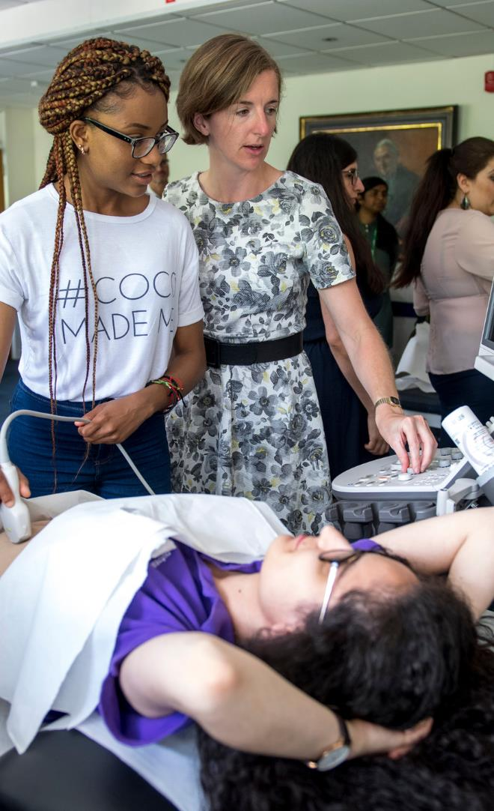
What are the Pathways Programmes?
Sutton Trust Pathways programmes are designed to help you explore your chosen profession. You will get to attend a variety of different sessions with top employers, make new friends and start planning your next steps!
What will you get out of it?
Work
placement
Professional
networking
University
App
Support
Employability
skill
sessions
Notes:
Pathways programmes are two year programmes that are designed to give you an insight into exciting professions as well as university life. Along the way, you will start thinking about your next steps after leaving school – learning more about university, apprenticeships and what career path will suit you. All this while meeting employers and making new friends! These programmes are completely free to attend and be a part of – there will never be a cost for you! ​
What will you get out of it?
- The opportunity for 3 - 5 days of experience within your chosen field at one of our partner companies.
- Gain access to personal statement and teacher recommendation building tools, interview and admissions test support, and university-led admissions webinars.
- Meet with professionals in the industry and gain their top tips and insights into applying for and succeeding in your chosen profession.
- Gain new skills including networking, presenting, communication & many more

Slide 4
What are Sutton Trust Summer Schools ?
This programme will provide you with the confidence and skills needed to: choose where to apply and what to study, be competitive applicants wherever that is, and find support with a network of like-minded peers.
What will you get out of it?
You can choose from over 40 courses at one of our 14 top tier university partners at which you can participate in:
Social
activities
Application skills workshops
Taster academic sessions

Slide 5
What is the Sutton Trust US Programme?
The Sutton Trust US Programme is designed to support students in exploring the American university experience, financial aid options, and application process. From UK residentials to a trip to the US to visit different American colleges, you will get an in-depth look into what it’s like to study in the USA.
What will you get out of it?
SUTTON TRUST
University visits
UK Residentials
University Application Support
Admission test support
Notes:
What will you get out of it?
- A week-long trip to explore US universities (COVID restrictions dependent).
- Expert advice throughout the application process via the US-UK Fulbright Commission.
- Residentials in the UK which provide in-depth support and advice on the US admissions process.
- In-depth admissions test preparation.

Slide 6
What is the Apprenticeship Summer School?
The Sutton Trust apprenticeship programme is a three-day residential where you can meet leading employers and like-minded peers and learn more about how to access top apprenticeships. High-quality apprenticeships not only offer you the opportunity to earn while you learn but also ensure you gain valuable skills and get a foot on the career ladder.
SUTTON TRUST
What are the benefits?
Understanding apprenticeships
Professional networking
Application guidance
Notes:
What are the benefits?
- An in depth understanding of apprenticeships and whether they could be the right route for you.
- Application guidance, including learning where to find current apprenticeships and understanding different application processes.
- Meet with professionals in the industry and gain their top tips and insights into
applying for and succeeding in apprenticeships.

Slide 7
Sutton Trust Online
Access a digital platform that is a one stop shop for everything you need to know about university​.
Use a personal statement builder and a subject-specific mentor​.
Speak to current undergraduates and Sutton Trust alumni to find out what life is really like​.
Delve into the library of resources to help you explore, apply, prepare and succeed at university​.
Attend exclusive webinars and events​.
Ongoing support throughout the last two years of school or college​.
SUTTON TRUST
Notes:
Pathways programmes are two year programmes that are designed to give you an insight into exciting professions as well as university life. Along the way, you will start thinking about your next steps after leaving school – learning more about university, apprenticeships and what career path will suit you. All this while meeting employers and making new friends! These programmes are completely free to attend and be a part of – there will never be a cost for you! ​

Slide 8
Who can apply?
SUTTON TRUST
MANDATORY CRITERIA
ACADEMIC CRITERIA
SOCIAL MOBILITY CRITERIA
Are currently in:​
Year 12 (England and Wales)​
Year 13 (Northern Ireland)​
S5 (Scotland)
Attend, and have always attended, a state (non fee-paying) school
Have excellent academic grades
We look at a number of additional criteria to offer places on the programme. These include:
Your background​
Your school’s context​
Where you live

Slide 9
How do I apply?
SUTTON TRUST
Discover which programme is right for you and apply at https://www.suttontrust.com/our-programmes/
Complete the online application form at apply.suttontrust.com ahead of the deadline listed on The Sutton Trust website.
You will hear from your university or the Trust within a couple of weeks of applications closing to confirm whether you have a place.

Slide 10
"The Pathways to Law programme supplied so much. On the intellectual front, masterclasses and residentials meant I was regularly meeting with passionate academics. On the practical front, networking events and work placements meant I had the opportunity to meet a wide range of industry professionals. Six years on, I still use many of the lessons taught on the programme on a day-to-day basis."
Testimonials
SUTTON TRUST
"I was given unique insights from employers and apprentices, and on a personal level I was pushed beyond my boundaries. I am so glad that I took this opportunity to experience and would highly recommend it to those who are thinking about the apprenticeship route."
"Taking part in the summer school has helped me gain confidence. I feel like I'm a competitive applicant now, while before I just thought I'd be lucky if I was offered a place at any university."

