Slide 1


Estimating the costs associated with changes in the student support offer
An analysis on behalf of the Sutton Trust
November 2017

Slide 2

Overview of scenarios
Scenario | Overview | Tuition fees |  | Maintenance | Interest rates
 |  | HH income | Level
Baseline | Baseline student support arrangements for new students in 2017/18 | Old baseline: Loan repayment threshold of £21,000, interest rate threshold of £41,000 (both frozen for 4 years) New baseline: Loan repayment threshold of £25,000, interest rate threshold of £45,000 (both frozen for 0 years)
Scenario 1 (Multi-step fees) | Multi-step means-tested fees Maintenance loans only 0-3% real interest rate | <=£25,000 <=£50,000 <=£75,000 <=£100,000 >£100,000 | £0 £3,250 £6,250 £9,250 £12,250 | Maintenance loans only (2017/18 arrangements) | RPI + up to 3% (means-tested)
Scenario 2 (Multi-step fees + grant) | Multi-step means-tested fees Maintenance loans + grants 0-3% real interest rate | <=£25,000 <=£50,000 <=£75,000 <=£100,000 >£100,000 | £0 £3,250 £6,250 £9,250 £12,250 | Maintenance loans + grants (2015-16 arrangements) | RPI + up to 3% (means-tested)
Scenario 3 (Low income fee waiver + grants) | Low-income fee waiver Maintenance loans + grants 0-3% real interest rate | <=£25,000 >£25,000 | £0 £9,250 | Maintenance loans + grants (2015-16 arrangements) | RPI + up to 3% (means-tested)
Scenario 4 (Scenario 1 + 0% real interest rate) | Multi-step means-tested fees Maintenance loans only 0% real interest rate | <=£25,000 <=£50,000 <=£75,000 <=£100,000 >£100,000 | £0 £3,250 £6,250 £9,250 £12,250 | Maintenance loans only (2017/18 arrangements) | RPI (non-means-tested)
Scenario 5 (Scenario 2 + 0% real interest rate) | Multi-step Maintenance loans + grants 0% real interest rate | <=£25,000 <=£50,000 <=£75,000 <=£100,000 >£100,000 | £0 £3,250 £6,250 £9,250 £12,250 | Maintenance loans + grants (2015-16 arrangements) | RPI (non-means-tested)
Scenario 6 (Scenario 3 + 0% real interest rate) | Low-income fee waiver Maintenance loans + grants 0% real interest rate | <=£25,000 >£25,000 | £0 £9,250 | Maintenance loans + grants (2015-16 arrangements) | RPI (non-means-tested)
Note: For the means-tested fees, we apply the same household income bands for full-time and part-time students. The full-time bands are based on students’ household income distribution (using information provided by the Student Loans Company), where bands above £25,000 and below £100,000 have been set to arrive at a roughly equal proportion of students within each band.
The combined maintenance grants and maintenance loans in Scenarios 2, 3, 5 ad 6 are based on the support available in 2017/18 for continuing students who started their qualification in 2015/16 or earlier. Finally, under each of the alternative scenarios, given the means-testing applied to tuition fees, we assume that universities would no longer be obliged to provide any fee or other types of bursaries to students (given that students with from low-income households would pay lower tuition fees than students from wealthier households).

Slide 3
Headline figures
…assuming no correlation between parental household income and graduate earnings
Note: All monetary values have been discounted to present net present values (using standard HMT Green Book discount rates), and are presented in constant 2017/18 prices. Graduate lifetime loan repayments have been rounded to the nearest £100.
Debt on graduation and expected lifetime repayments per student are presented for full-time undergraduate degree students only, and have been rounded to the nearest £100.
Gross fee income refers to fee income before the deduction of the costs of fee bursaries provided to students.

Slide 4


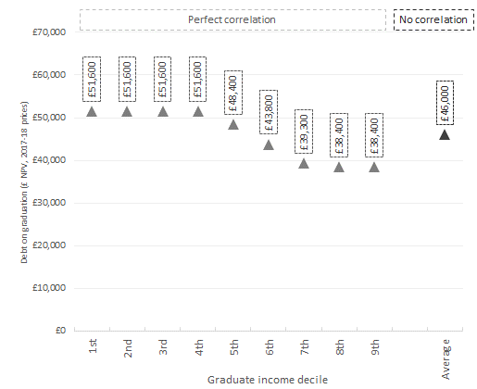
Pre Oct 2017 (Baseline A)
£21,000 repayment threshold &
£41,000 interest threshold (4 year freeze)
Graduate lifetime loan repayments – full-time undergraduate degrees (by decile and gender)
Resource flows | Amount (£)
Exchequer
Cost of maintenance grant provision | £0m
Cost of maintenance loan provision | (£1,638m)
Cost of tuition fee loan provision | (£2,706m)
Cost of teaching grants | (£1,294m)
Total | (£5,637m)
% of loans that is never repaid (RAB) | 27.6%
Higher Education Institutions’ income
Gross fee income | £9,985m
Teaching grant income | £1,294m
Cost of bursary provision | (£191m)
Total | £11,087m
Students
Average debt on graduation (FTUG) | £46,000
Debt on graduation by household income decile

Slide 5
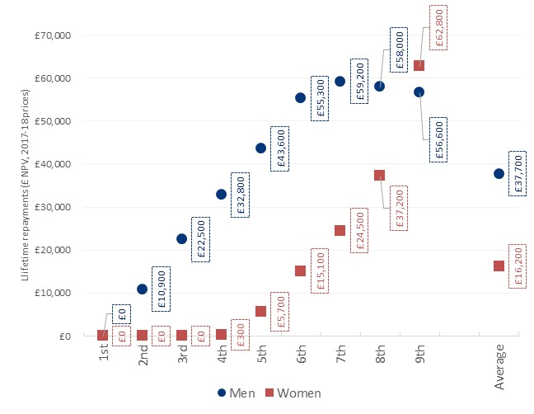
Post Oct 2017 (Baseline B)
£25,000 repayment threshold &
£45,000 interest threshold (no freeze)
Graduate lifetime loan repayments – full-time undergraduate degrees (by decile and gender)
Resource flows | Baseline A | Baseline B | Diff.
Exchequer
Cost of maintenance grant provision | £0m | £0m | £0m
Cost of maintenance loan provision | (£1,638m) | (£2,728m) | (£1,090m)
Cost of tuition fee loan provision | (£2,706m) | (£4,469m) | (£1,763m)
Cost of teaching grants | (£1,294m) | (£1,294m) | £0m
Total | (£5,637m) | (£8,491m) | (£2,853m)
% of loans that is never repaid (RAB) | 27.6% | 45.1% | 17.5 pp
Higher Education Institutions
Gross fee income | £9,985m | £9,985m | £0m
Teaching grant income | £1,294m | £1,294m | £0m
Cost of bursary provision | (£191m) | (£191m) | £0m
Total | £11,087m | £11,087m | £0m
Students
Average debt on graduation (FTUG) | £46,000 | £46,000 | £0
Debt on graduation by household income decile

Slide 6
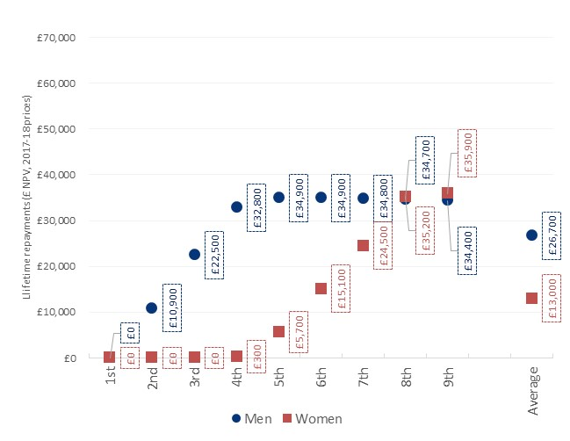
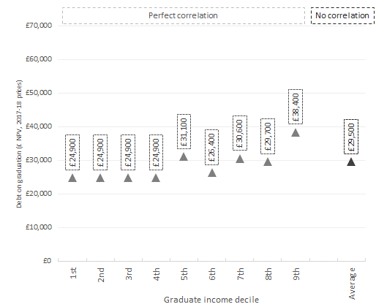
Scenario 1
Multi-step means-tested fees
Maintenance loans only
0-3% real interest rate
Graduate lifetime loan repayments – full-time undergraduate degrees (by decile and gender)
Resource flows | Baseline | Scenario 1 | Diff.
Exchequer
Cost of maintenance grant provision | £0m | £0m | £0m
Cost of maintenance loan provision | (£2,728m) | (£2,205m) | £524m
Cost of tuition fee loan provision | (£4,469m) | (£1,330m) | £3,138m
Cost of teaching grants | (£1,294m) | (£1,294m) | £0m
Total | (£8,491m) | (£4,829m) | £3,662m
% of loans that is never repaid (RAB) | 45.1% | 37.1% | -7.9 pp
Higher Education Institutions
Gross fee income | £9,985m | £3,665m | (£6,320m)
Teaching grant income | £1,294m | £1,294m | £0m
Cost of bursary provision | (£191m) | £0m | £191m
Teaching grant compensation |  | £6,129m
Total | £11,087m | £11,087m | £0m
Total additional cost (compared to Baseline B) |  | £2,467m
Students
Average debt on graduation (FTUG) | £46,000 | £29,500 | (£16,500)
Debt on graduation by household income decile

Slide 7
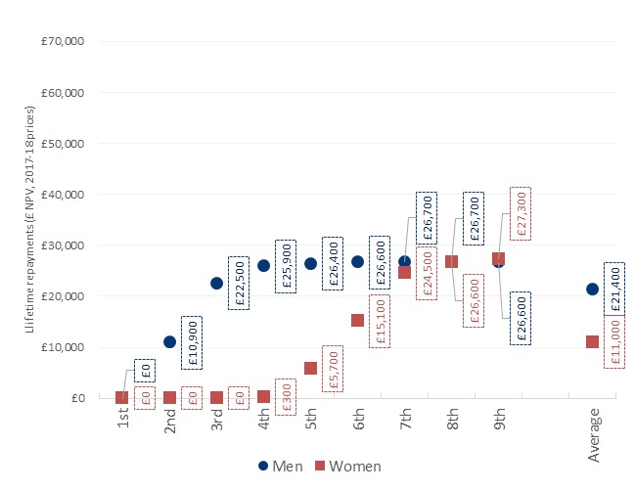
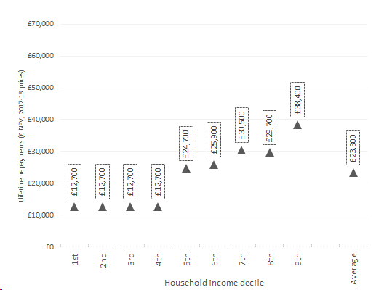
Scenario 2
Multi-step means-tested fees
Maintenance loans + grants
0-3% real interest rate
Graduate lifetime loan repayments – full-time undergraduate degrees (by decile and gender)
Resource flows | Baseline | Scenario 2 | Diff.
Exchequer
Cost of maintenance grant provision | £0m | (£1,629m) | (£1,629m)
Cost of maintenance loan provision | (£2,728m) | (£1,396m) | £1,332m
Cost of tuition fee loan provision | (£4,469m) | (£1,246m) | £3,223m
Cost of teaching grants | (£1,294m) | (£1,294m) | £0m
Total | (£8,491m) | (£5,564m) | £2,927m
% of loans that is never repaid (RAB) | 45.1% | 35.2% | -9.9 pp
Higher Education Institutions
Gross fee income | £9,985m | £3,665m | (£6,320m)
Teaching grant income | £1,294m | £1,294m | £0m
Cost of bursary provision | (£191m) | £0m | £191m
Teaching grant compensation |  | £6,129m
Total | £11,087m | £11,087m | £0m
Total additional cost (compared to Baseline B) |  | £3,202m
Students
Average debt on graduation (FTUG) | £46,000 | £23,300 | (£22,700)
Debt on graduation by household income decile

Slide 8
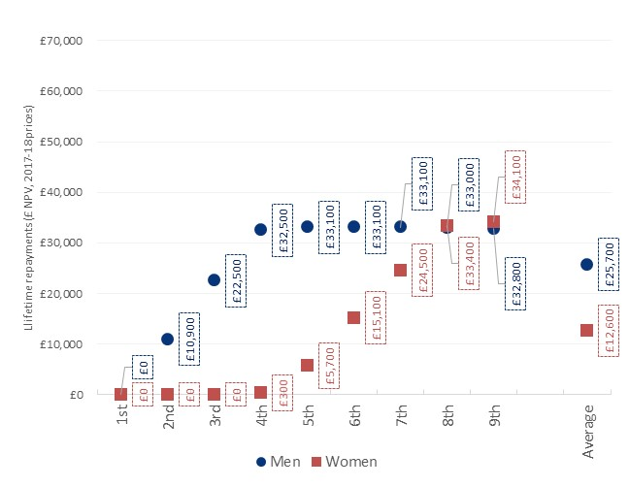
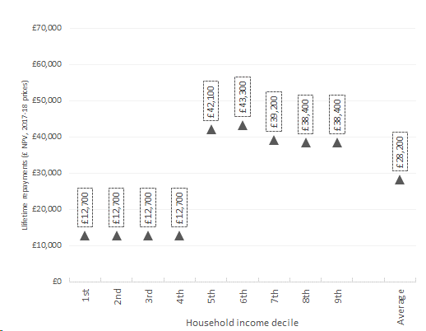
Scenario 3
Low-income fee waiver
Maintenance loans + grants
0-3% real interest rate
Graduate lifetime loan repayments – full-time undergraduate degrees (by decile and gender)
Resource flows | Baseline | Scenario 3 | Diff.
Exchequer
Cost of maintenance grant provision | £0m | (£1,629m) | (£1,629m)
Cost of maintenance loan provision | (£2,728m) | (£1,476m) | £1,252m
Cost of tuition fee loan provision | (£4,469m) | (£1,993m) | £2,476m
Cost of teaching grants | (£1,294m) | (£1,294m) | £0m
Total | (£8,491m) | (£6,391m) | £2,100m
% of loans that is never repaid (RAB) | 45.1% | 37.0% | -8.0 pp
Higher Education Institutions
Gross fee income | £9,985m | £5,530m | (£4,455m)
Teaching grant income | £1,294m | £1,294m | £0m
Cost of bursary provision | (£191m) | £0m | £191m
Teaching grant compensation |  | £4,263m
Total | £11,087m | £11,087m | £0m
Total additional cost (compared to Baseline B) |  | £2,163m
Students
Average debt on graduation (FTUG) | £46,000 | £28,200 | (£17,800)
Debt on graduation by household income decile

Slide 9

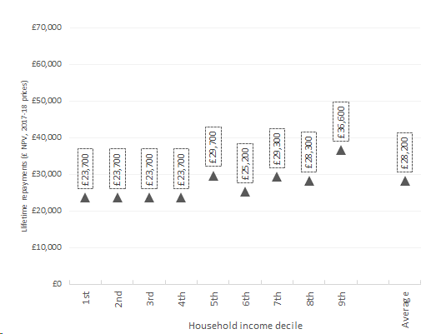
Scenario 4
Multi-step means-tested fees
Maintenance loans only
0% real interest rate
Graduate lifetime loan repayments – full-time undergraduate degrees (by decile and gender)
Resource flows | Baseline | Scenario 4 | Diff.
Exchequer
Cost of maintenance grant provision | £0m | £0m | £0m
Cost of maintenance loan provision | (£2,728m) | (£2,913m) | (£184m)
Cost of tuition fee loan provision | (£4,469m) | (£1,738m) | £2,731m
Cost of teaching grants | (£1,294m) | (£1,294m) | £0m
Total | (£8,491m) | (£5,945m) | £2,546m
% of loans that is never repaid (RAB) | 45.1% | 46.9% | 1.8 pp
Higher Education Institutions
Gross fee income | £9,985m | £3,665m | (£6,320m)
Teaching grant income | £1,294m | £1,294m | £0m
Cost of bursary provision | (£191m) | £0m | £191m
Teaching grant compensation |  | £6,129m
Total | £11,087m | £11,087m | £0m
Total additional cost (compared to Baseline B) |  | £3,583m
Students
Average debt on graduation (FTUG) | £46,000 | £28,200 | (£17,800)
Debt on graduation by household income decile

Slide 10
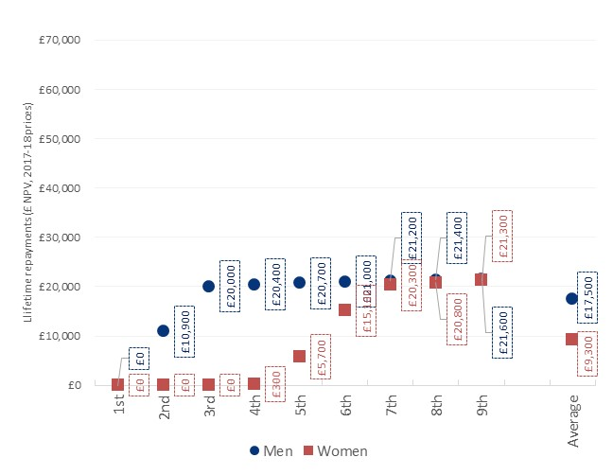
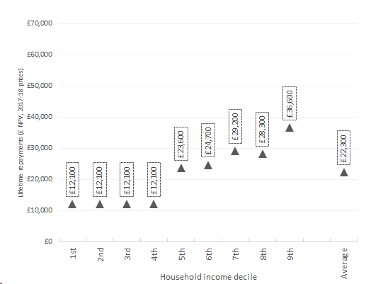
Scenario 5
Multi-step means-tested fees
Maintenance loans + grants
0% real interest rate
Graduate lifetime loan repayments – full-time undergraduate degrees (by decile and gender)
Resource flows | Baseline | Scenario 5 | Diff.
Exchequer
Cost of maintenance grant provision | £0m | (£1,629m) | (£1,629m)
Cost of maintenance loan provision | (£2,728m) | (£1,866m) | £863m
Cost of tuition fee loan provision | (£4,469m) | (£1,644m) | £2,825m
Cost of teaching grants | (£1,294m) | (£1,294m) | £0m
Total | (£8,491m) | (£6,432m) | £2,059m
% of loans that is never repaid (RAB) | 45.1% | 44.7% | -0.3 pp
Higher Education Institutions
Gross fee income | £9,985m | £3,665m | (£6,320m)
Teaching grant income | £1,294m | £1,294m | £0m
Cost of bursary provision | (£191m) | £0m | £191m
Teaching grant compensation |  | £6,129m
Total | £11,087m | £4,958m | £0m
Total additional cost (compared to Baseline B) |  | £4,070m
Students
Average debt on graduation (FTUG) | £46,000 | £22,300 | (£23,700)
Debt on graduation by household income decile

Slide 11
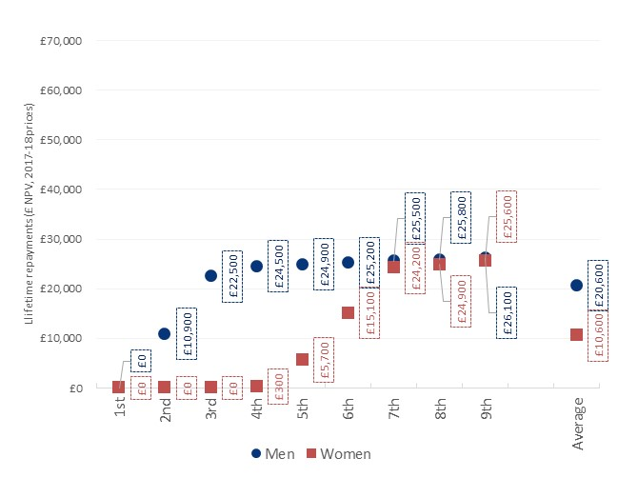
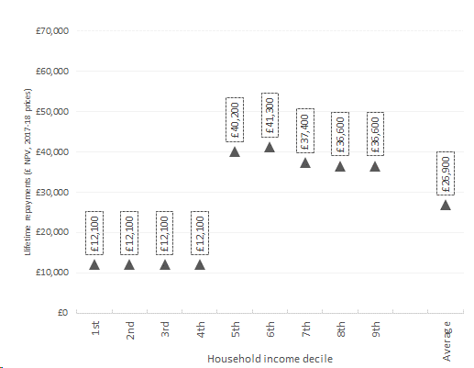
Scenario 6
Low-income fee waiver
Maintenance loans + grants
0% real interest rate
Graduate lifetime loan repayments – full-time undergraduate degrees (by decile and gender)
Resource flows | Baseline | Scenario 6 | Diff.
Exchequer
Cost of maintenance grant provision | £0m | (£1,629m) | (£1,629m)
Cost of maintenance loan provision | (£2,728m) | (£1,950m) | £778m
Cost of tuition fee loan provision | (£4,469m) | (£2,593m) | £1,875m
Cost of teaching grants | (£1,294m) | (£1,294m) | £0m
Total | (£8,491m) | (£7,466m) | £1,025m
% of loans that is never repaid (RAB) | 45.1% | 46.8% | 1.8 pp
Higher Education Institutions
Gross fee income | £9,985m | £5,530m | (£4,455m)
Teaching grant income | £1,294m | £1,294m | £0m
Cost of bursary provision | (£191m) | £0m | £191m
Teaching grant compensation |  | £4,263m
Total | £11,087m | £6,824m | £0m
Total additional cost (compared to Baseline B) |  | £3,238m
Students
Average debt on graduation (FTUG) | £46,000 | £26,900 | (£19,100)
Debt on graduation by household income decile

Slide 12
Sensitivity analysis
…assuming perfect correlation between parental household income and graduate earnings
The previous estimates were based on the average level of maintenance loan and tuition fee loan taken out by students across all household income deciles – i.e. we assumed that there is no correlation between parental income and graduate earnings. This information on average fee and maintenance loans was then combined with the earnings of graduates on different post-graduation income deciles, to calculate the overall RAB charge and repayments by post-graduation income deciles.
To analyse the sensitivity of the results, the following slides present the results of a sensitivity analysis, assuming that there is perfect correlation between parental income and graduate earnings – i.e. we assume that individuals who are on the lowest household income decile when enrolling in their studies will be on the lowest graduate earnings decile after completing their studies.

Slide 13
Sensitivity analysis
The previous estimates were based on the average level of maintenance loan and tuition fee loan taken out by students across all household income deciles – i.e. we assumed that there is no correlation between parental income and graduate earnings. This information on average fee and maintenance loans was then combined with the earnings of graduates on different post-graduation income deciles, to calculate the overall RAB charge and repayments by post-graduation income deciles.
To analyse the sensitivity of the results, the following slides present the results of a sensitivity analysis, assuming that there is perfect correlation between parental income and graduate earnings – i.e. we assume that individuals who are on the lowest household income decile when enrolling in their studies will be on the lowest graduate earnings decile after completing their studies.

Slide 14
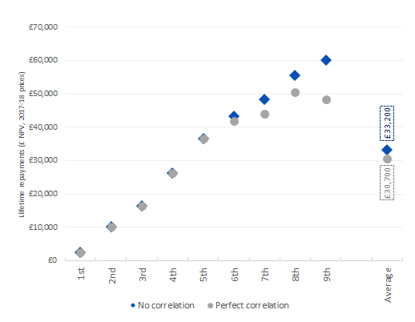
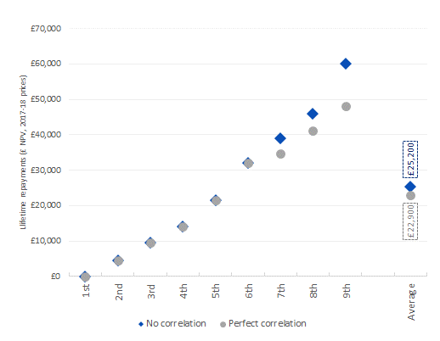
Pre Oct 2017 (Baseline A)
Sensitivity analysis
Loan repayments by income decile
In the following, we present additional information average graduate lifetime loan repayments across both men and women (again focusing on full-time undergraduate degrees), for both the headline results (assuming no correlation between parental income and graduate earnings) as well as for the sensitivity analysis (assuming perfect correlation between parental income and graduate earnings).
£21,000 repayment threshold &
£41,000 interest threshold (4 year freeze)
Post Oct 2017 (Baseline B)
£25,000 repayment threshold &
£45,000 interest threshold (no freeze)

Slide 15
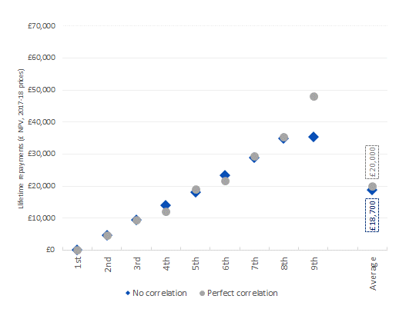
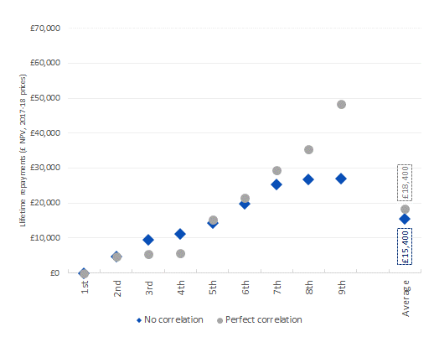
Sensitivity analysis
Loan repayments by income decile
Scenario 1
Multi-step means-tested fees
Maintenance loans only
0-3% real interest rate
Scenario 2
Multi-step means-tested fees
Maintenance loans + grants
0-3% real interest rate

Slide 16
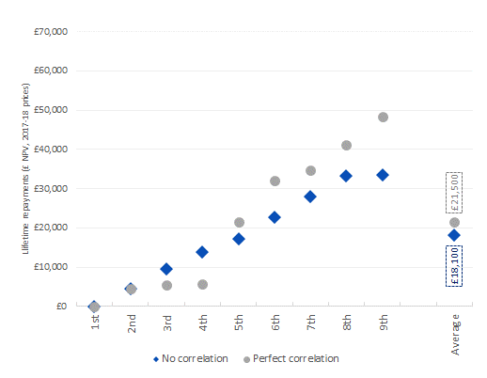
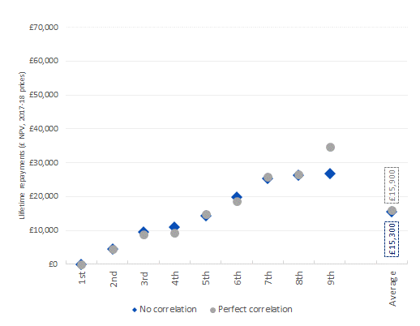
Sensitivity analysis
Loan repayments by income decile
Scenario 3
Low-income fee waiver
Maintenance loans + grants
0-3% real interest rate
Scenario 4
Multi-step means-tested fees
Maintenance loans only
0% real interest rate

Slide 17
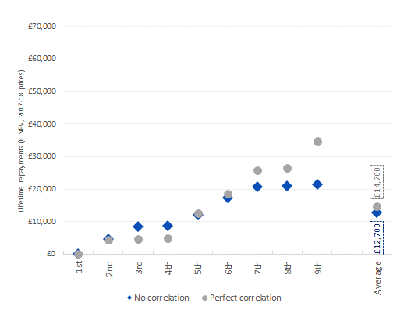
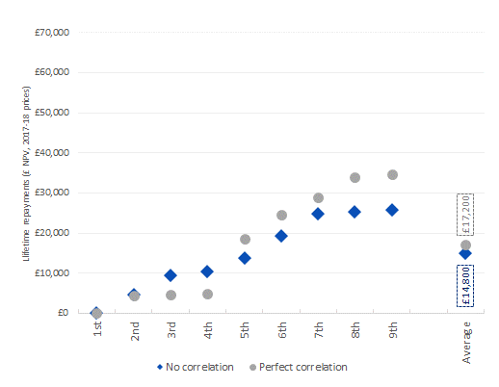
Sensitivity analysis
Loan repayments by income decile
Scenario 5
Multi-step means-tested fees
Maintenance loans + grants
0% real interest rate
Scenario 6
Low-income fee waiver
Maintenance loans + grants
0% real interest rate

Slide 18

Authors
Ms Maike Halterbeck, Senior Economic Consultant, London Economics
020 3701 7724, mhalterbeck@londecon.co.uk
Dr Gavan Conlon, Partner, London Economics
020 3701 7703, gconlon@londecon.co.uk
@LE_Education
Cover picture:
Patpitchaya/Shutterstock.com

